Slide 1
CEM/
SCEM
CEM/
SCEM
CEM/
SCEM
BPM
AEM
BPM
AEM
BPM
AEM
BPM
-
+
-
-
+
-
-
+
-
-
+
+
+
+
-
+
-
+
-
-
+
-
-
+
-
-
+
+
+
+
-
-
-
-
-
-
-
+
+
+
EC
SWBC
AC
BC
Notes:
Fig. 1 The configuration of BMED stack (EC: electrode chamber; SWBC: seawater brine chamber; AC: acid chamber; BC: base chamber).

Slide 2
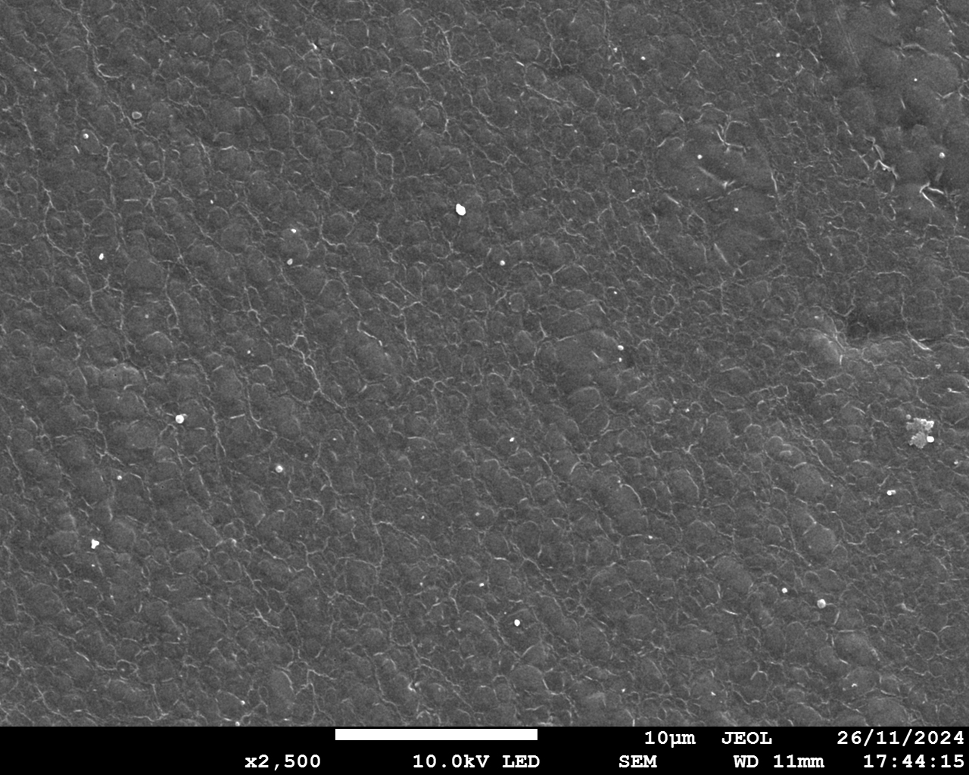
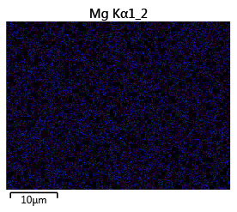
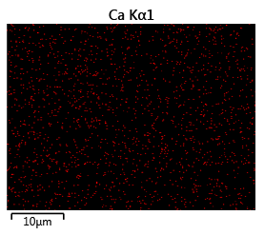
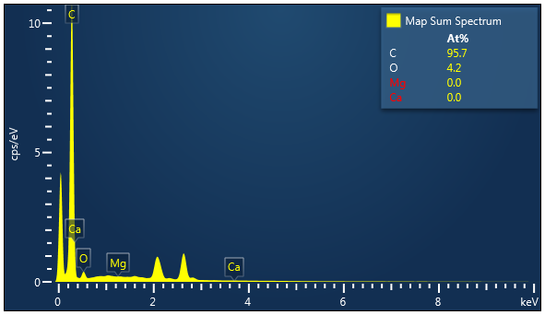
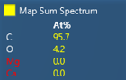
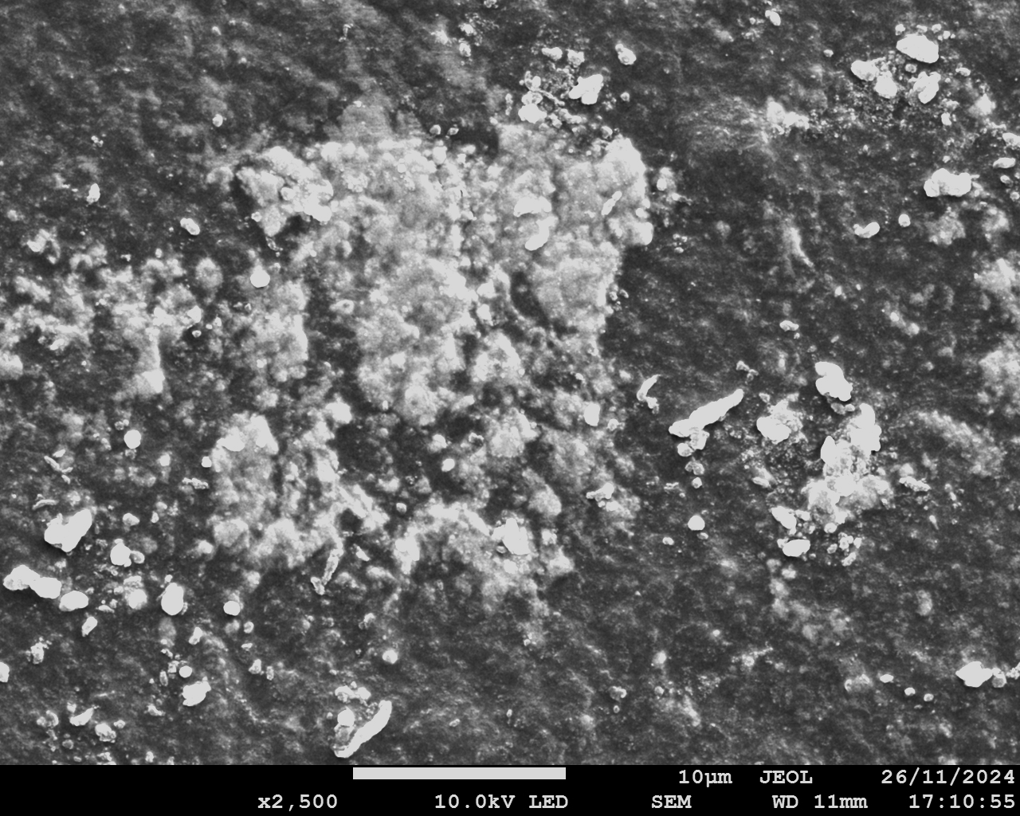
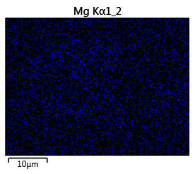
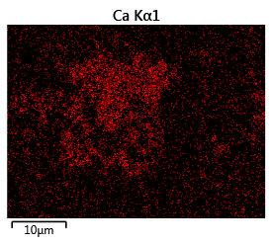
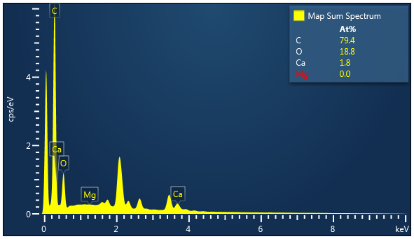
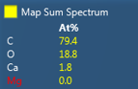
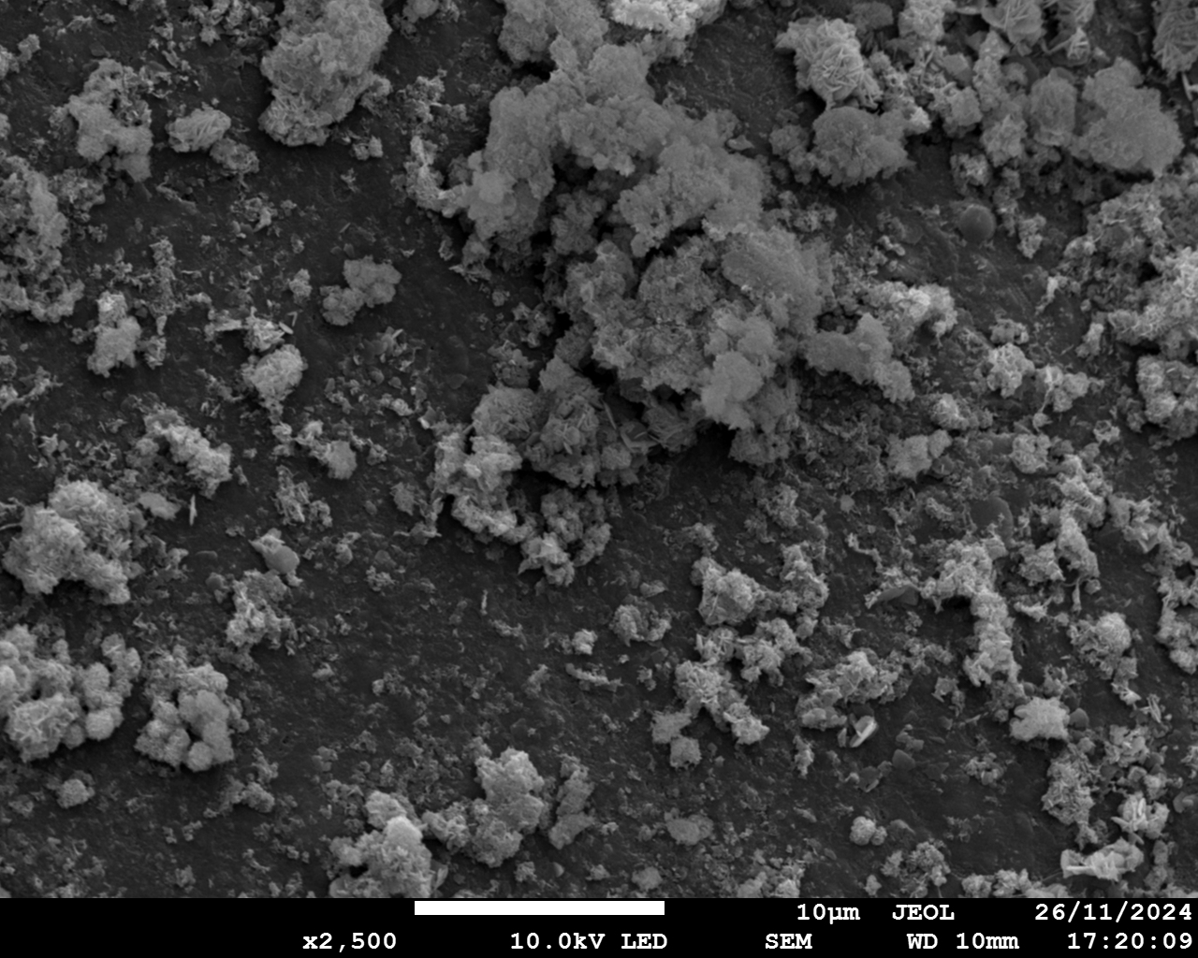
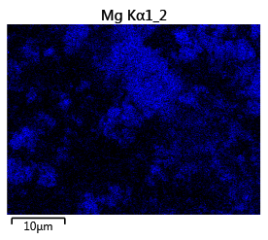
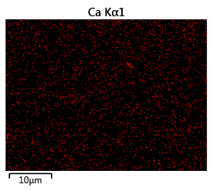
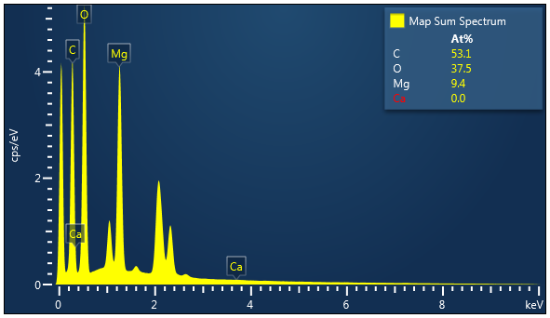
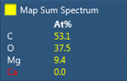
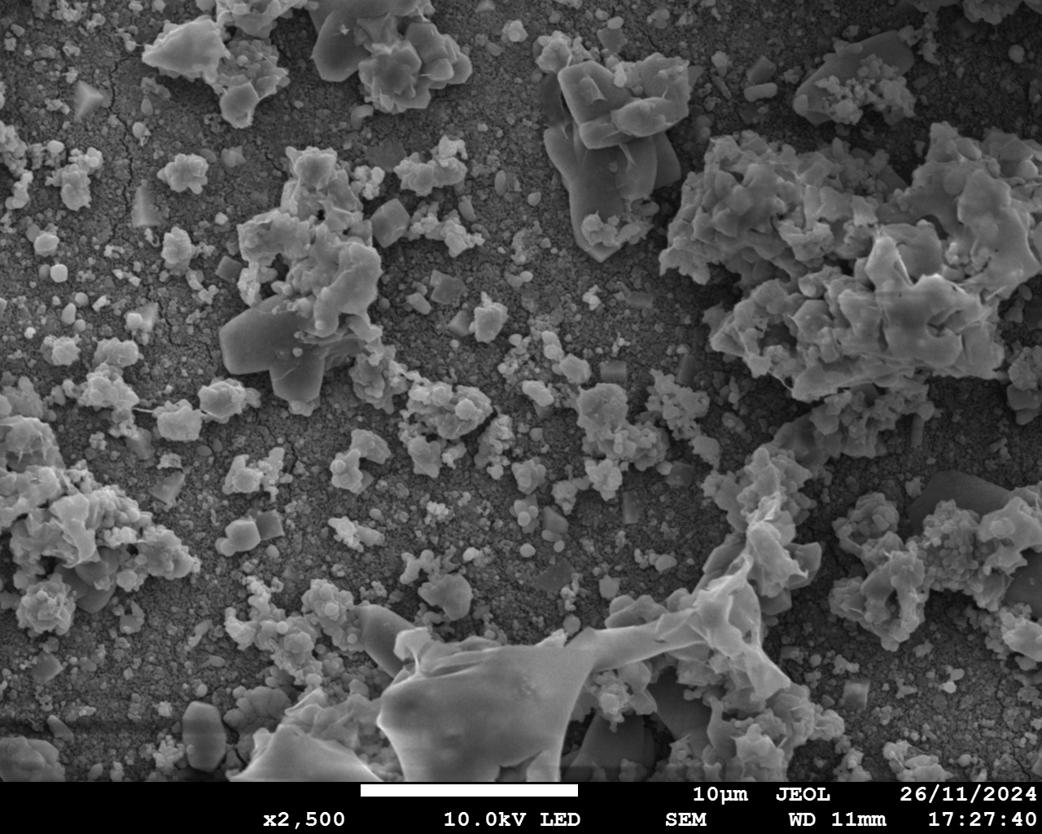
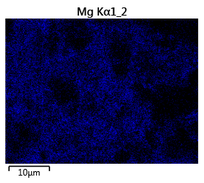
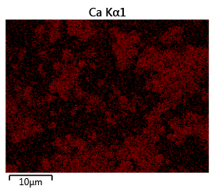
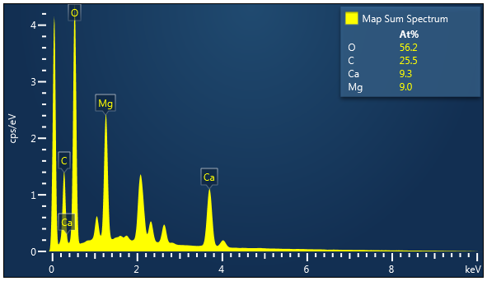
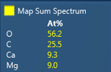
a1
a2
Mg
a3
Ca
a4
10 μm
10 μm
10 μm
b1
b2
Mg
b3
Ca
b4
10 μm
10 μm
10 μm
c1
c2
Mg
c3
Ca
c4
10 μm
10 μm
10 μm
d1
d2
d3
d4
Mg
Ca
10 μm
10 μm
10 μm
Notes:
Fig. 2 Characterization of scaling on membranes (Conditions: Feed solution = seawater brine, current density = 15 mA/cm², cell pairs = 3, membrane = CEM. AC: acid chamber; SWBC: seawater brine chamber; BC: base chamber). AEM facing SWBC: (a1) SEM diagram; (a2) EDS elemental mapping image of Mg; (a3) EDS elemental mapping image of Ca; (a4) EDS map spectrum. BPM facing BC: (b1) SEM diagram; (b2) EDS elemental mapping image of Mg; (b3) EDS elemental mapping image of Ca; (b4) EDS map spectrum. CEM facing SWBC: (c1) SEM diagram; (c2) EDS elemental mapping image of Mg; (c3) EDS elemental mapping image of Ca; (c4) EDS map spectrum. CEM facing BC: (d1) SEM diagram; (d2) EDS elemental mapping image of Mg; (d3) EDS elemental mapping image of Ca; (d4) EDS map spectrum.

Slide 3
BPM
AEM
CEM/SCEM
BPM
BPM
EC
AC
+
SWBC
-
BC
EC
-
3
+
OH⁻
Cl⁻
Ca²⁺
+
-
…
+
1
2
-
OH⁻
H⁺
OH⁻
-
OH⁻
H⁺
+
Mg²⁺
Ca²⁺
Na⁺
-
Ca²⁺
Mg²⁺
Na⁺
+
+
-
1
2
3
Scaling on CEM/SCEM
facing SWBC
Scaling on CEM/SCEM
facing BC
Scaling on BPM
facing BC
Scaling: Mg(OH)₂
The leakage of OH⁻
Scaling: Mg(OH)₂, Ca(OH)₂, CaCO₃
The transport of Mg²⁺/Ca²⁺
Scaling: Ca(OH)₂
The transport of Mg²⁺/Ca²⁺
Notes:
Fig. 3 Schematic illustration of mechanisms of scaling generation in BMED system (EC: electrode chamber; AC: acid chamber; SWBC: seawater brine chamber; BC: base chamber).

Slide 4
a
b
c
d
e
Notes:
Figure 4 Quantification of scaling in BMED system. (a) Reduction ratio of Mg²⁺ and Ca²⁺ with time; (b) The amount of scaling in BMED. The concentration change of Mg²⁺ and Ca²⁺ with time in (c) AC, (d) BC and (e) SWBC. (Conditions: Feed solution = seawater brine, current density = 15 mA/cm², cell pairs = 3, membrane = CEM. AC: acid chamber; BC: base chamber; SWBC: seawater brine chamber).

Slide 5
a
b
c
d
e
Notes:
Figure 5 (a) Conductivity changes in salt chamber and (b) Voltage changes in BMED system treating NaCl and seawater brine (SWB). (c) Concentration of generated acid and base with time. The current efficiency and energy consumption of the entire process to produce (d) acid and (e) base. (Conditions: Feed solution = SWB or NaCl, current density = 15 mA/cm², cell pairs = 3, membrane = CEM)

Slide 6
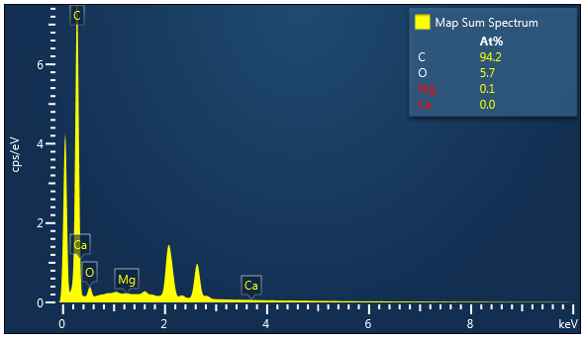
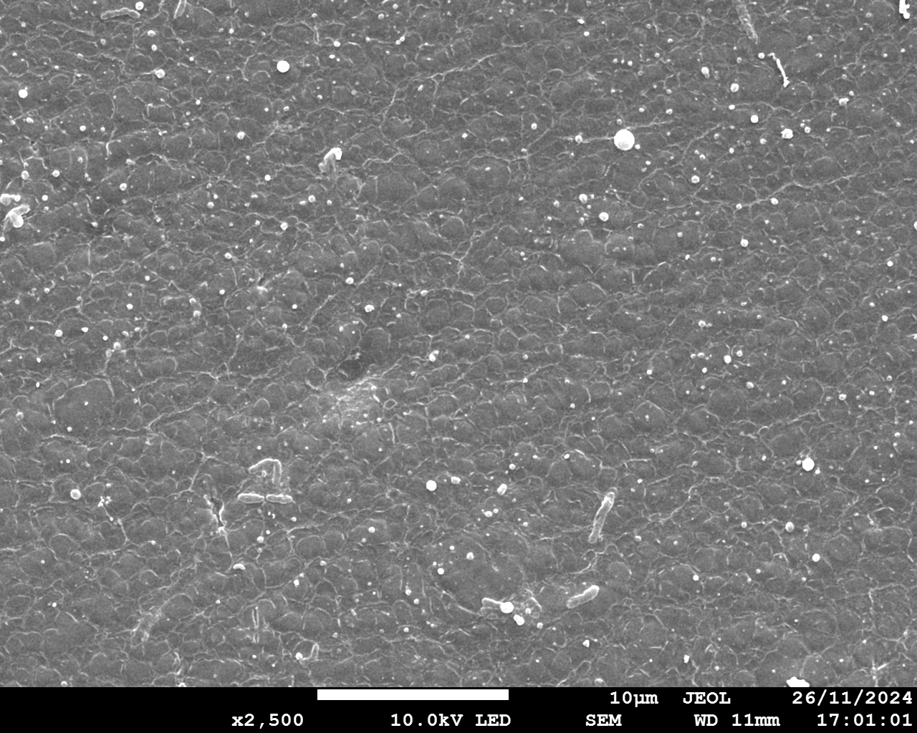
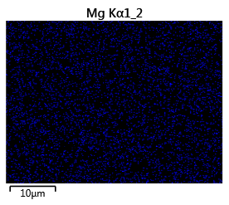
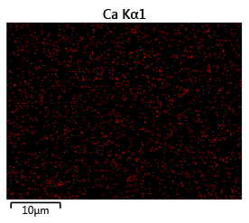
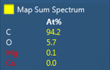
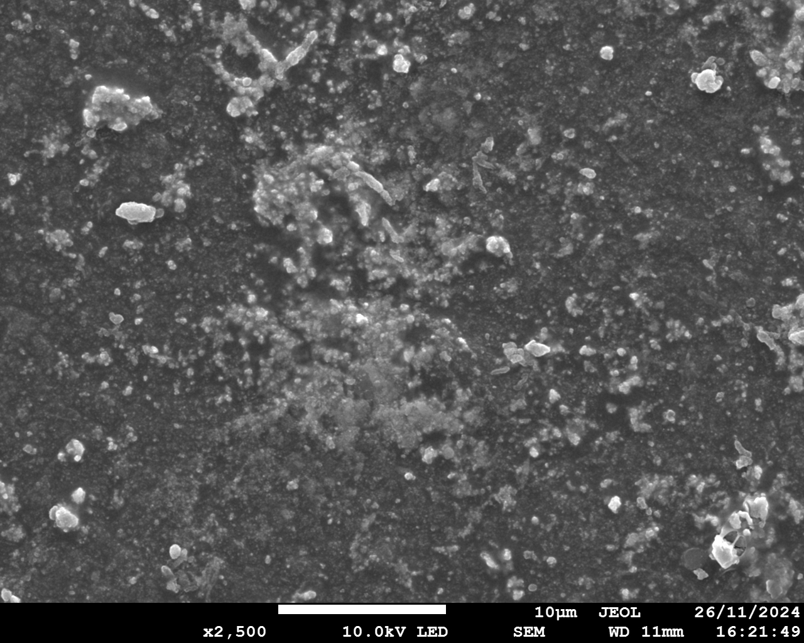
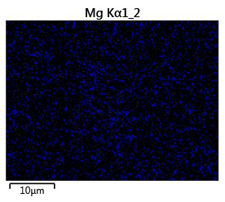
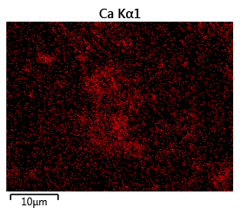
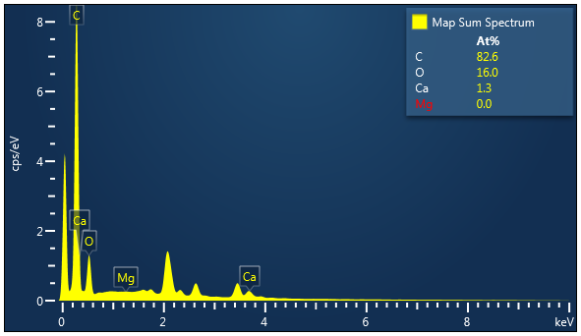
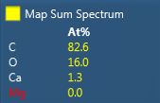
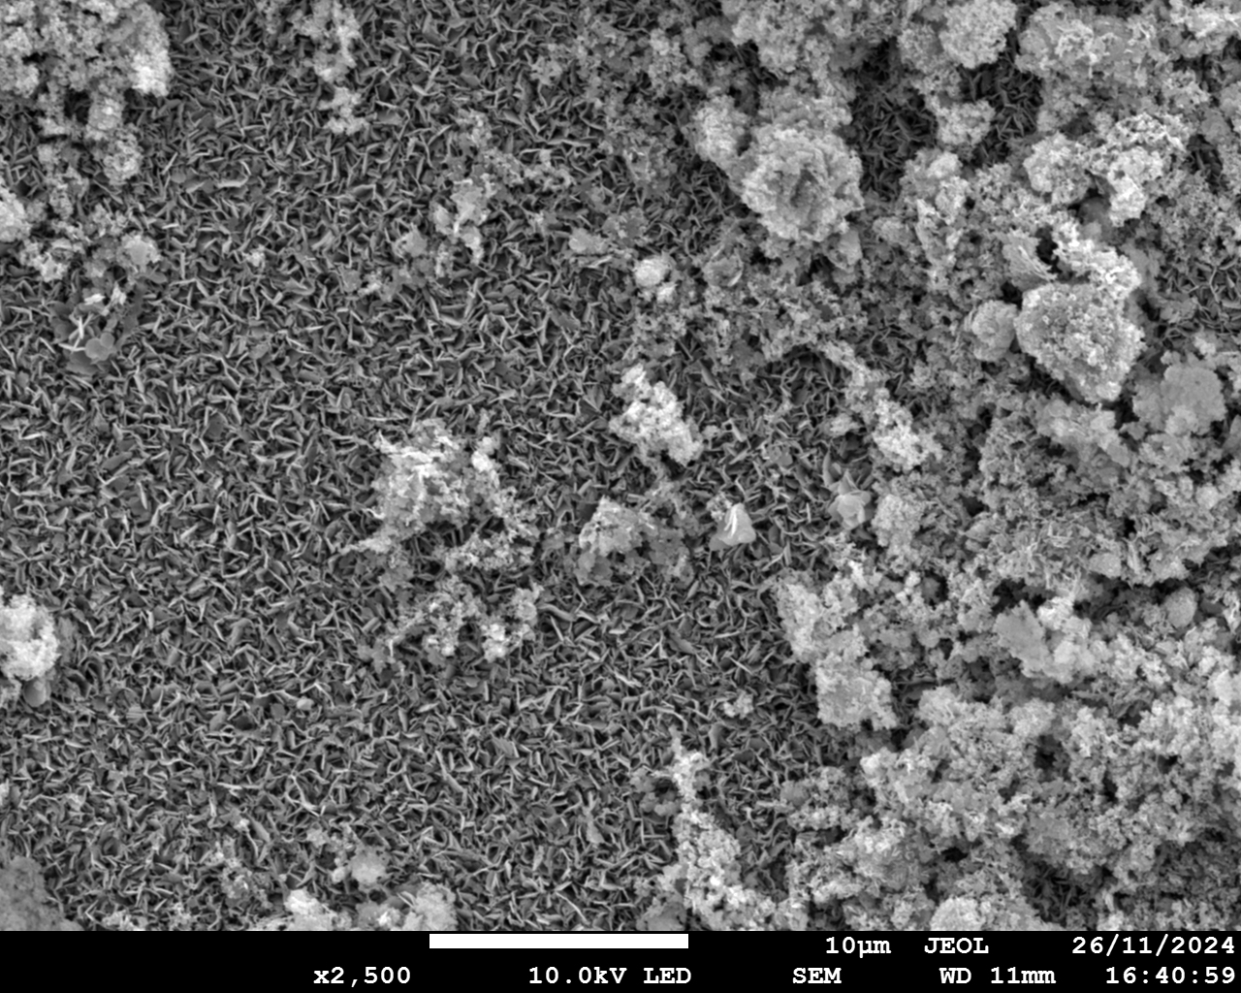
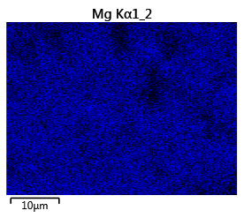
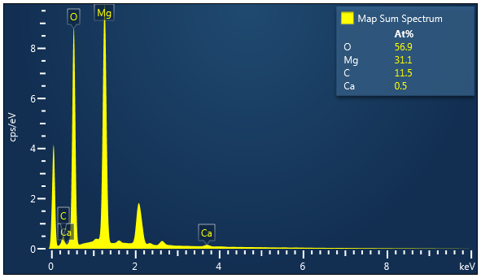
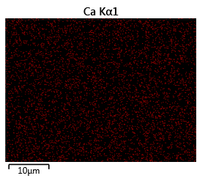
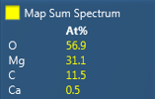
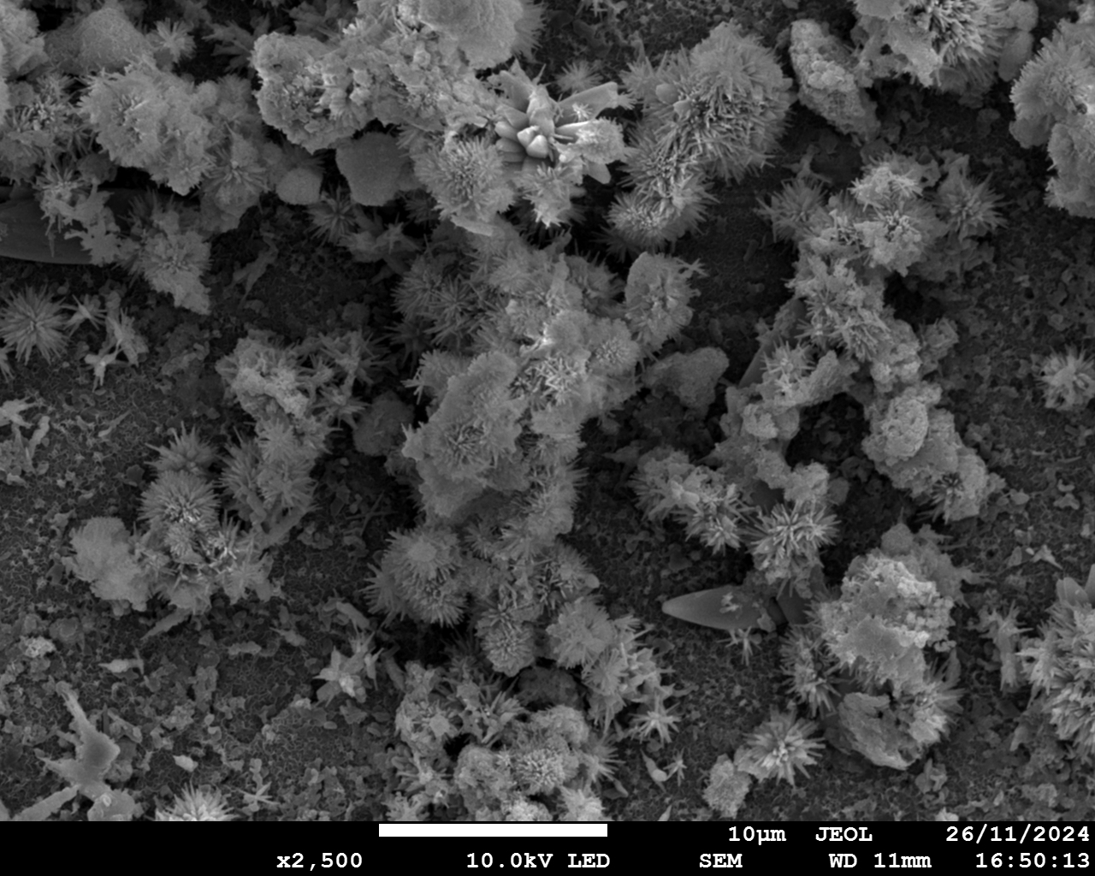
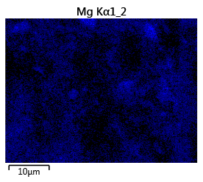
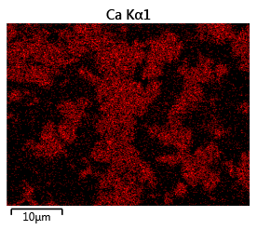
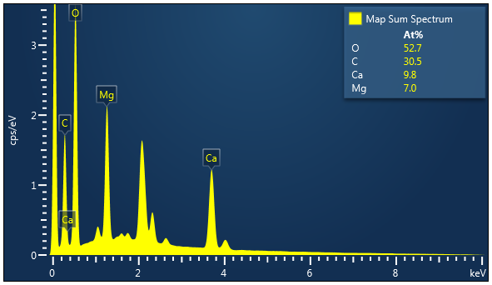
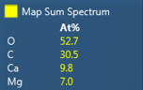
a1
a2
Mg
a3
Ca
a4
10 μm
10 μm
10 μm
b1
b2
b3
b4
Mg
Ca
10 μm
10 μm
10 μm
c1
c2
Mg
c3
c4
Ca
10 μm
10 μm
10 μm
d1
d2
d3
d4
Mg
Ca
10 μm
10 μm
10 μm
Notes:
Figure 6 Characterization of scaling on membranes (Conditions: Feed solution = seawater brine, current density = 15 mA/cm², cell pairs = 3, membrane = SCEM). AEM facing SWBC: (a1) SEM diagram; (a2) EDS elemental mapping image of Mg; (a3) EDS elemental mapping image of Ca; (a4) EDS map spectrum. BPM facing BC: (b1) SEM diagram; (b2) EDS elemental mapping image of Mg; (b3) EDS elemental mapping image of Ca; (b4) EDS map spectrum. SCEM facing SWBC: (c1) SEM diagram; (c2) EDS elemental mapping image of Mg; (c3) EDS elemental mapping image of Ca; (c4) EDS map spectrum. SCEM facing BC: (d1) SEM diagram; (d2) EDS elemental mapping image of Mg; (d3) EDS elemental mapping image of Ca; (d4) EDS map spectrum.

Slide 7
a
b
c
d
e
Notes:
Figure 7 Quantification of scaling in BMED system (Conditions: Feed solution = seawater brine, current density = 15 mA/cm², cell pairs = 3, membrane = CEM (baseline, BL) and SCEM. AC: acid chamber; SWBC: seawater brine chamber; BC: base chamber). (a) Reduction ratio of Mg²⁺ and Ca²⁺ in BMED system treating SWB with different membrane stack; (b) The amount of scaling in BMED system with different membrane stack. The concentration change of Mg²⁺ and Ca²⁺ with time in (c) AC, (d) BC and (e) SWBC.

Slide 8
a
b
c
d
e
Notes:
Figure 8 (a) Conductivity change in salt chamber and (b) Voltage change with different membrane stack. (c) Concentration of generated acid and base with different membrane stack. The current efficiency and energy consumption of the entire process to produce (d) acid and (e) base with different membrane stack. (Conditions: Feed solution = seawater brine, current density = 15 mA/cm², cell pairs = 3, membrane = CEM (BL) and SCEM).

Slide 9
a
b
a
b
c
d
e
Notes:
Figure 9 Quantification of scaling under different current density (Conditions: Feed solution = seawater brine, cell pairs = 3, membrane = SCEM, current density = 15 (BL), 12 and 9 mA/cm². AC: acid chamber; SWBC: seawater brine chamber; BC: base chamber). (a) Reduction ratio of Mg²⁺ and Ca²⁺ in BMED system treating SWB under different current density; (b) The amount of scaling in BMED system under different current density. The concentration change of Mg²⁺ and Ca²⁺ with time in (c) AC, (d) BC and (e) SWBC.

Slide 10
a
b
c
d
e
Notes:
Figure 10 (a) Conductivity change in salt chamber and (b) Voltage change with time under different current density. (c) Concentration of generated acid and base under different current density. The current efficiency and energy consumption of the entire process to produce (d) acid and (e) base under different current density. (Conditions: Feed solution = seawater brine, cell pairs = 3, membrane = SCEM, current density = 15 (BL), 12 and 9 mA/cm²).

Slide 11
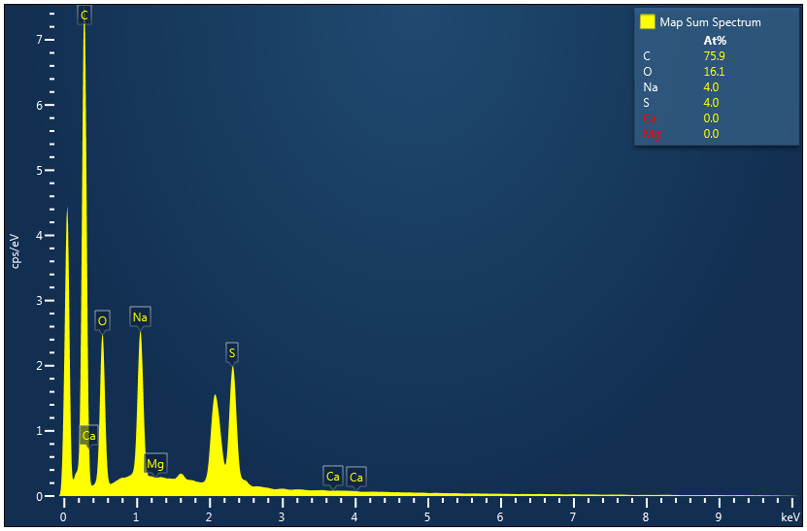
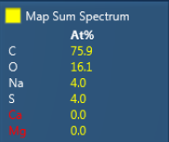
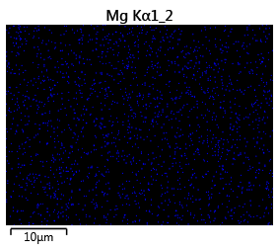
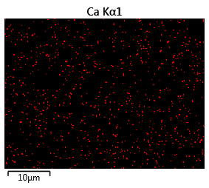
a
b
10 μm
c
Mg
d
Ca
10 μm
10 μm
Notes:
Figure S 1 Characterization of CEM (Conditions: feed solution = NaCl, current density = 15 mA/cm², cell pairs = 3). (a) SEM graph; (b) EDS map spectrum; (c) EDS elemental mapping image of Mg; (d) EDS elemental mapping image of Ca.

Slide 12
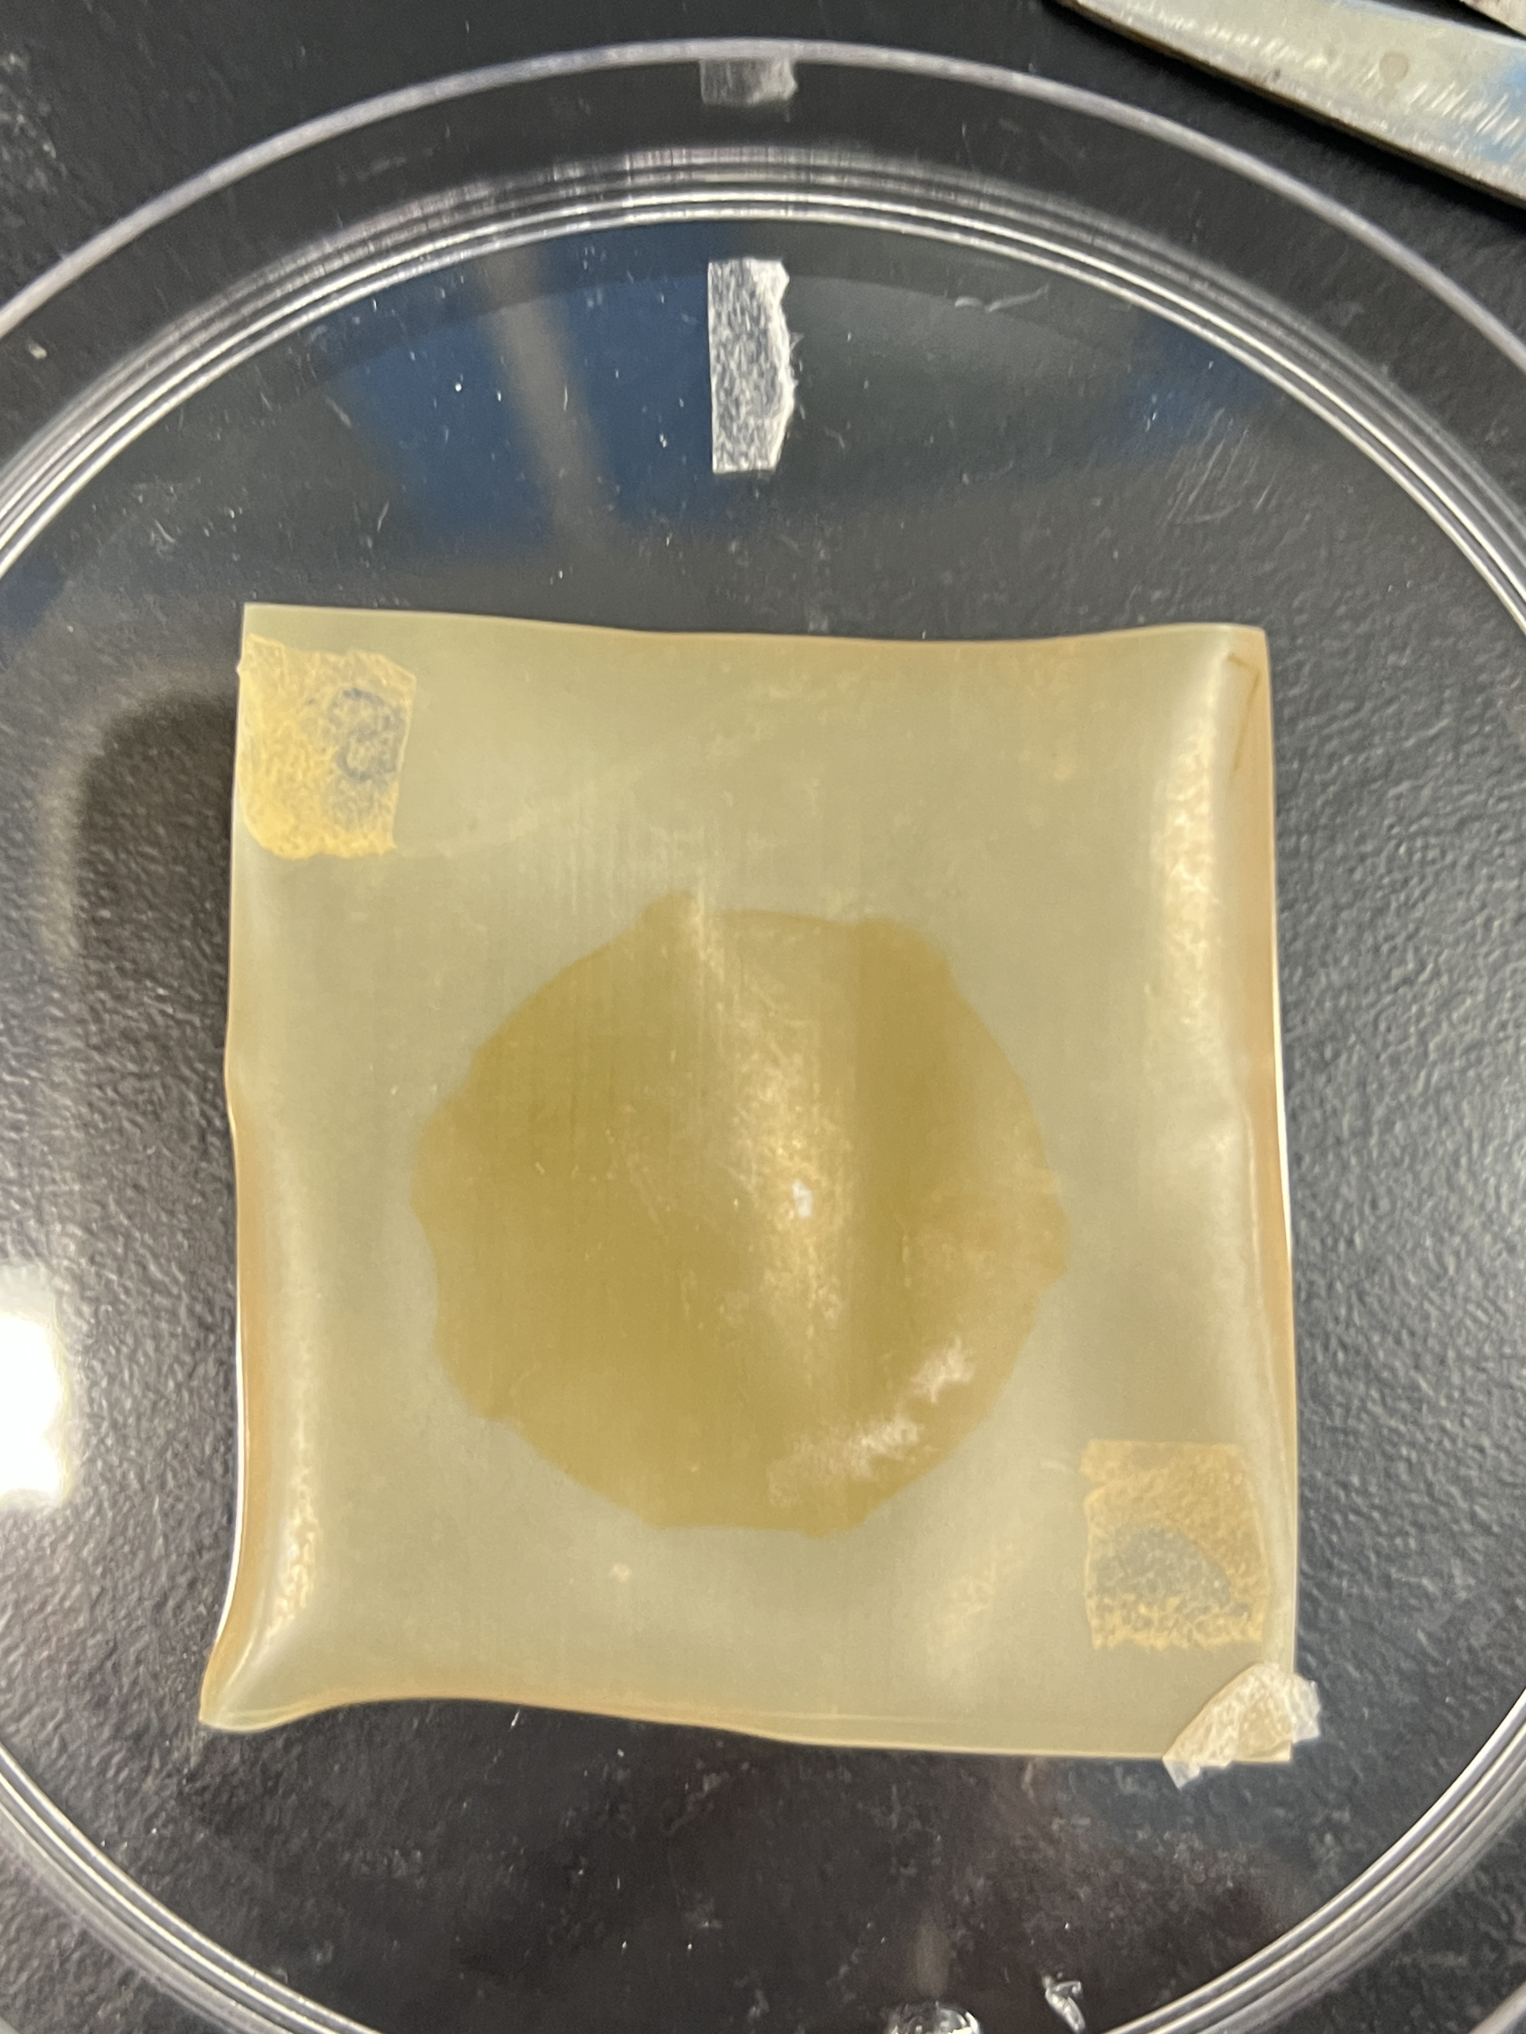
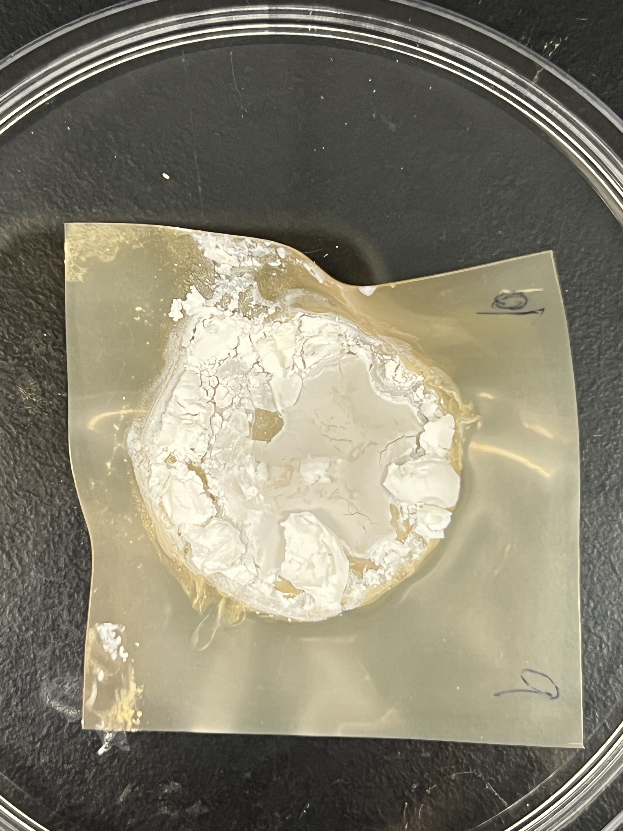
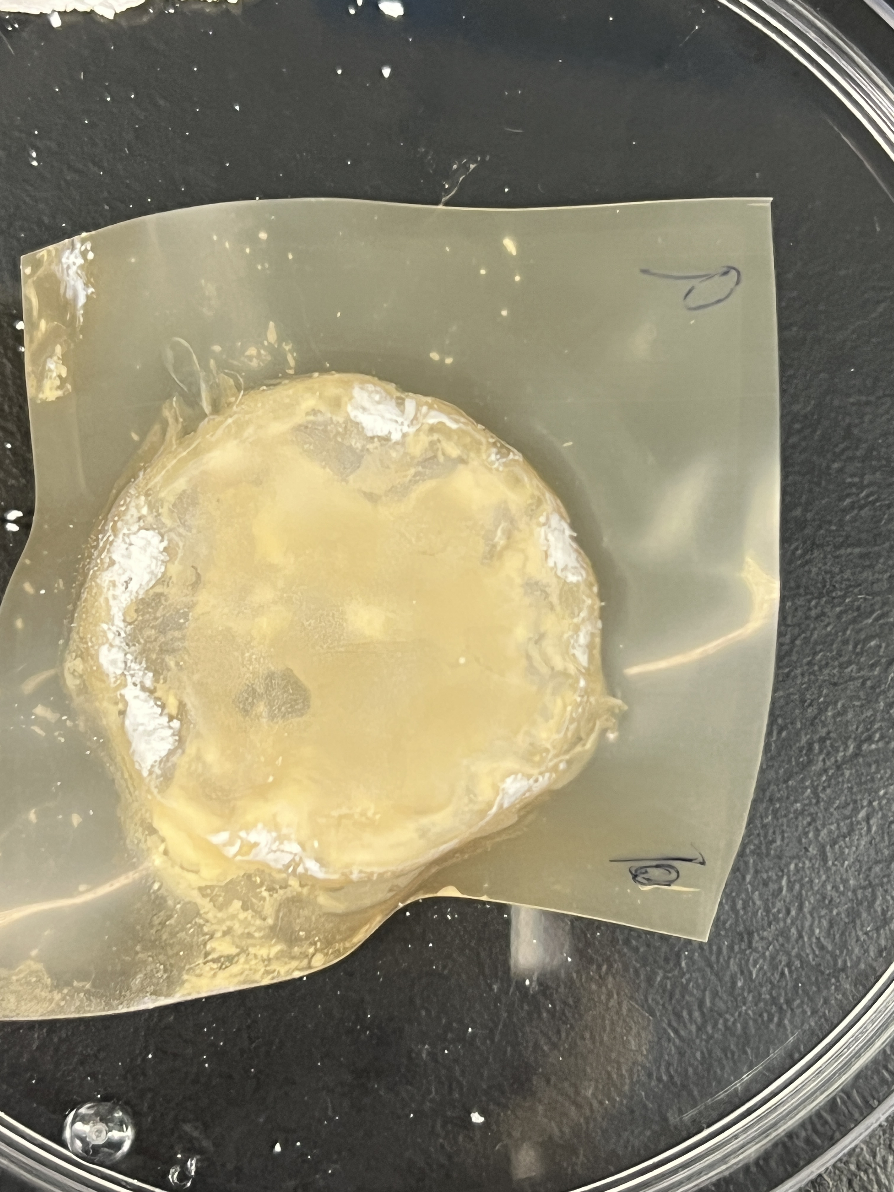
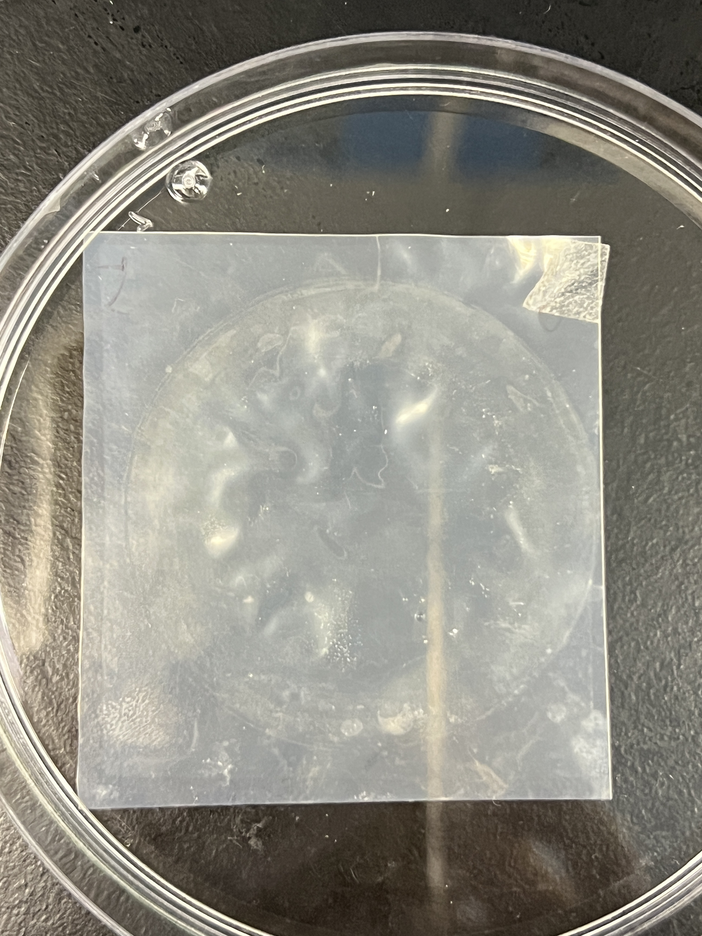
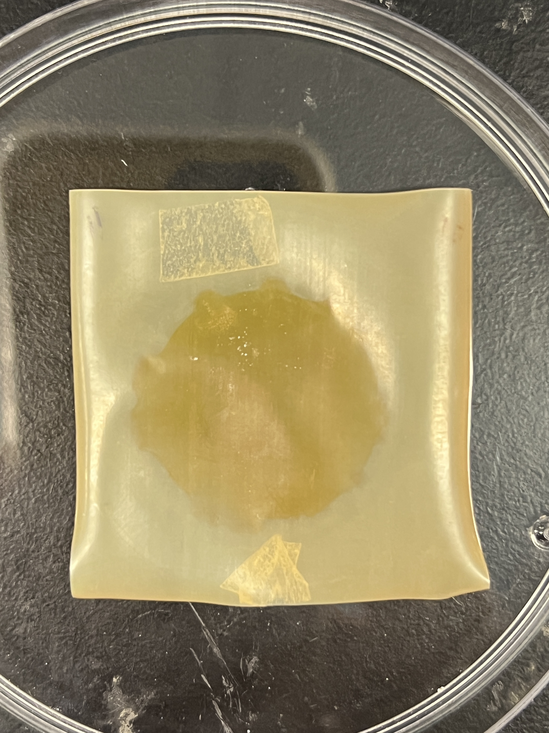
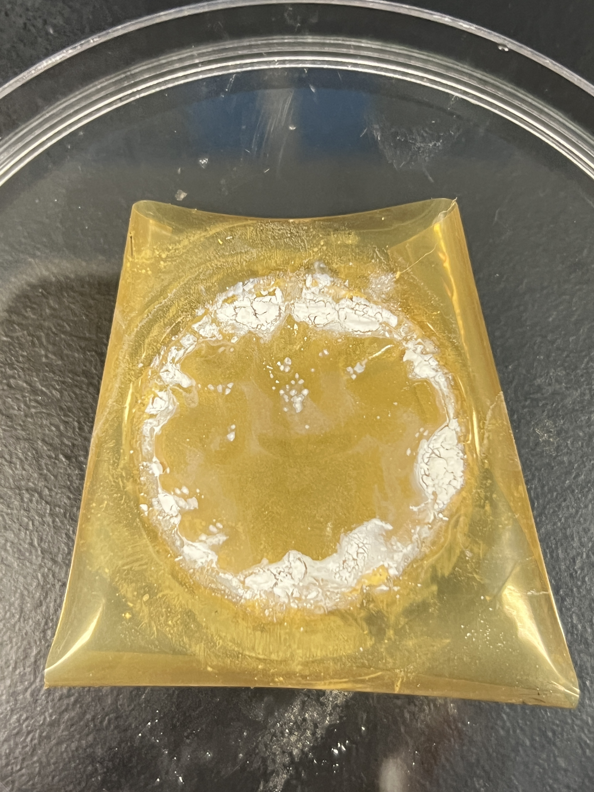


a1
a2
a3
a4
AEM facing SWBC
BPM facing BC
CEM facing SWBC
CEM facing BC
b1
b2
b3
b4
AEM facing SWBC
BPM facing BC
SCEM facing SWBC
SCEM facing BC
Notes:
Figure S2 The photo of membranes after test. BMED with CEM: (a1) AEM facing SWBC; (a2) BPM facing BC; (a3) CEM facing SWBC; (a4) CEM facing BC. BMED with SCEM: (b1) AEM facing SWBC; (b2) BPM facing BC; (b3) SCEM facing SWBC; (b4) SCEM facing BC.

Slide 13





10 μm
Mg
Ca
100 μm
100 μm

Slide 14





10 μm
100 μm
100 μm

